Slide 1


EEE 316 Project
Group No: 05
Prepared By:
1706008 – Sheikh Munim Hussain
1706017 – Jahidul Hoq Emon
1706020 – Shafin Shadman Ahmed
1706033 – Azazul Islam
Single-Phase Sine Wave Inverter
Submitted to:
Munia Ferdoushi
Satyaki Banik

Slide 2

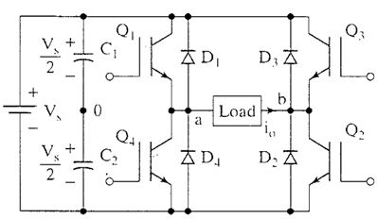

What is a DC-AC inverter?
An inverter converts the DC voltage to an AC voltage. In most cases, the input DC voltage is usually lower while the output AC is equal to the grid supply voltage of either 120 volts, or 240 Volts depending on the country.
In this project we used full bridge inverter to convert DC voltage to AC voltage. Our output was 220V AC.

Slide 3
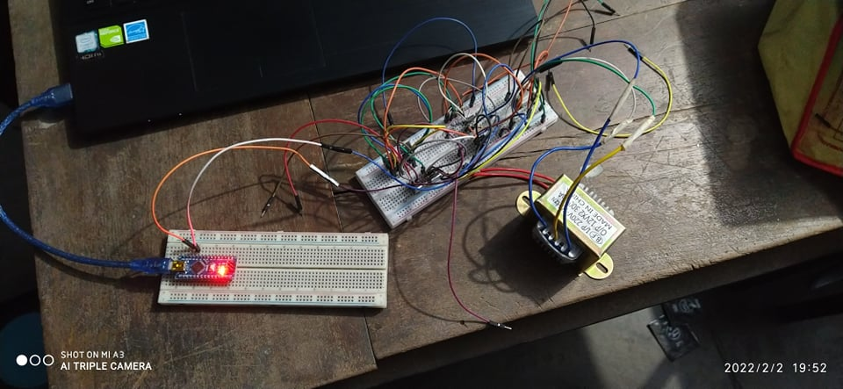

Hardware Circuit Diagram

Slide 4
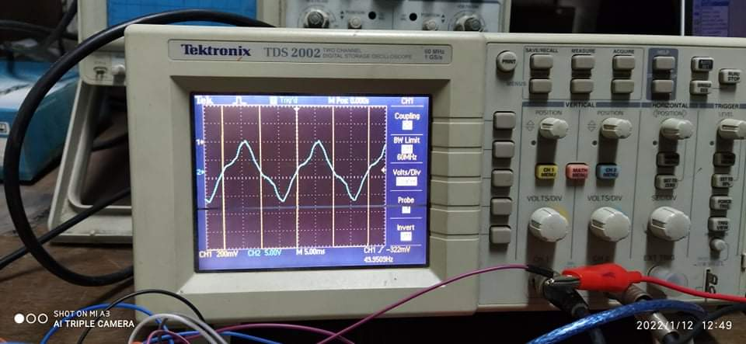
Hardware Circuit Output

Slide 5

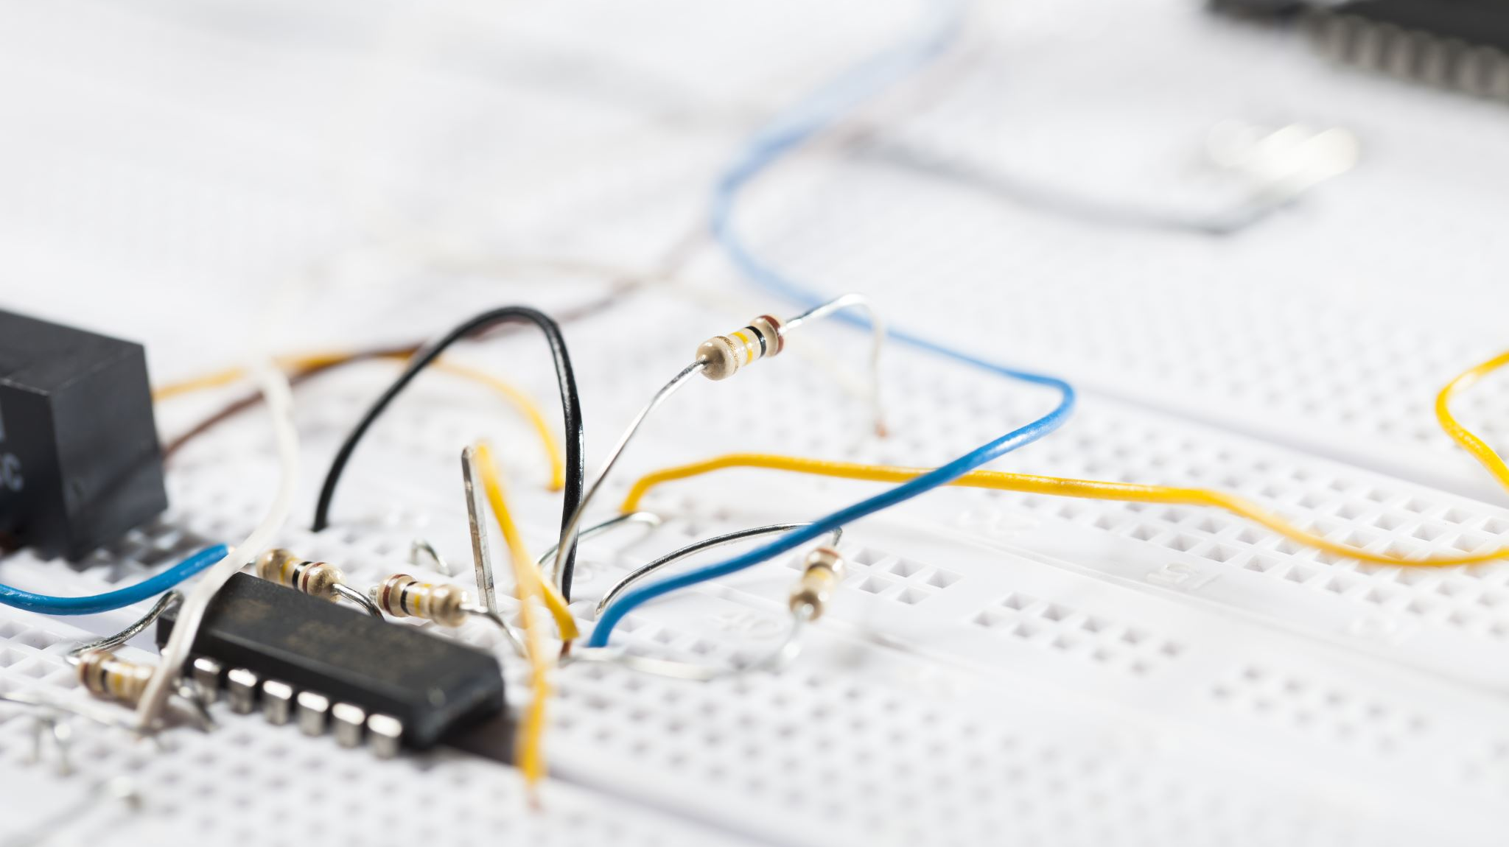
Reasons behind distorted output:
The filter that we used in the hardware circuit was very small (0.1µF). That’s why the output was not filtered out clearly. As a result, without getting pure sine wave, we are getting distorted sine wave.
The switching frequency that we used was too low. If we could increase the switching frequency, the output would be more accurate and close to sine wave.

